Slide 1

Crowdfunding overview
Collaborated by ~
Shefali Subhash Patial
Megha Manoj Marapurikal
Shubham Kanhere
Sandeep Prajapati
Adwait Panchal

Slide 2
What is Crowdfunding?
Crowdfunding is a method of raising funds for a project, venture, or cause by collecting small amounts of money from a large number of people, typically via online platforms.
It allows creators, entrepreneurs, or individuals to gather financial support from the general public, often without the need for traditional investment channels like banks or venture capital.
Michael Sullivan, to differentiate traditional fundraising with the trends of native Internet projects, companies and community efforts to support various kinds of creators. Crowdfunding has been used to fund a wide range of for-profit entrepreneurial ventures such as artistic and creative projects,medical expenses, travel, and community-oriented social entrepreneurship projects.

Slide 3

How its works crowdfunding?
Crowdfunding platforms typically work in the following way:
Project Creation: A project creator sets up a campaign on the crowdfunding platform, outlining their project, goals, and the rewards or perks they are offering to backers.
Funding Campaign: The campaign is launched and promoted to potential backers through the platform's network and the creator's own marketing efforts.
Backer Contributions: Backers can browse through available campaigns and choose to support projects they find interesting. They make contributions to the project in exchange for the promised rewards or perks.
Campaign Progress: The campaign's progress is tracked publicly on the platform, showing the amount raised and the number of backers.
Funding Deadline: Most crowdfunding campaigns have a set funding deadline. If the project reaches its funding goal by the deadline, the funds are collected and distributed to the project creator.
Rewards Fulfillment: If the campaign is successful, the project creator is responsible for fulfilling the rewards or perks promised to backers within a specified timeframe.

Slide 4

TYPES OF CROWDFUNDING
1. Rewards-Based Crowdfunding:
Backers pledge money in exchange for non-financial rewards, such as products, services, or exclusive experiences.
Popular for creative projects, tech products, and small businesses.
2.Donation-Based Crowdfunding:
Backers donate money to support a cause or project without expecting any direct reward.
3.Equity-Based Crowdfunding:
Backers invest money in a company in exchange for ownership shares.
Allows businesses to raise larger amounts of capital.
4.Debt-Based Crowdfunding:
Backers lend money to a borrower in exchange for interest payments.
Similar to peer-to-peer lending but often focused on specific projects or businesses.
5.Royalty-Based Crowdfunding:
Investors receive royalties, or a share of revenue generated by the project or business.
This is common in creative fields where a business or artist shares future earnings with backers, allowing them to earn a return without direct ownership.

Slide 5
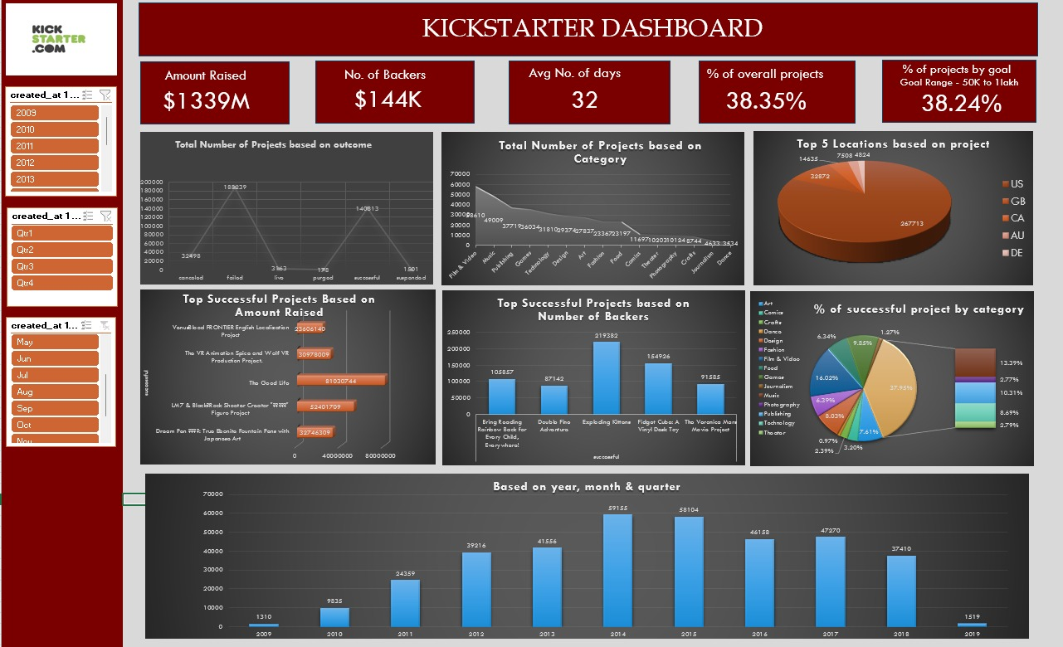
E
X
C
E
L
Top Categories: The most successful categories include Film & Video (377K projects) and Music (281K projects). However, categories like Technology and Publishing have lower participation.
Top Locations for Projects: US (267K projects) leads by a large margin, followed by the GB (32K), CA, AU, and DE.

Slide 6
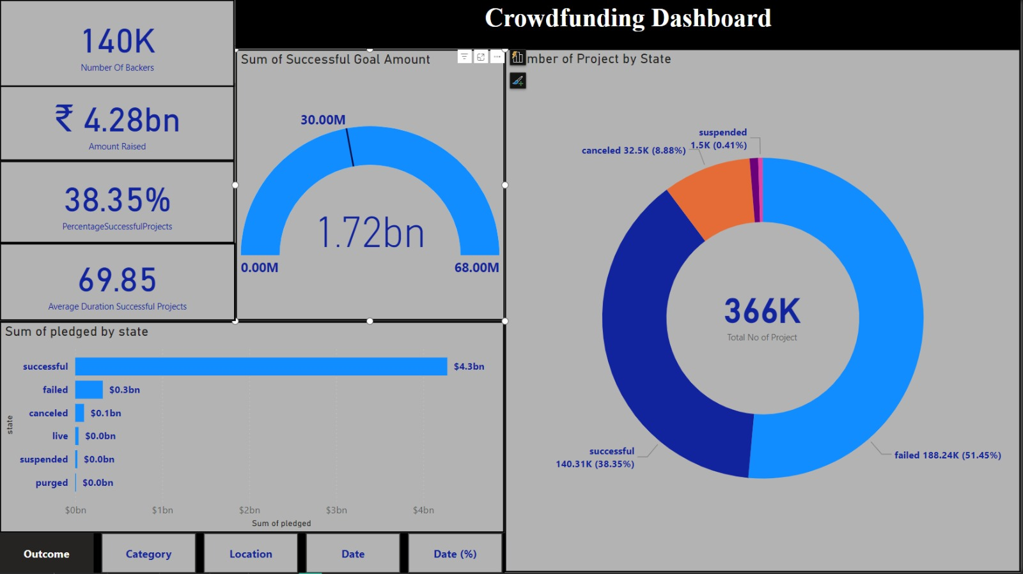
P
O
W
E
R
B
I
Sum of Pledged by State:
The successful projects dominate, with a total pledged amount of ₹4.3bn, significantly larger than other states.
Failed projects have a pledged sum of ₹0.3bn, indicating some level of contribution but ultimately unsuccessful outcomes.
Number of Projects by State:
Out of a total of 366K projects, the largest proportion are failed (188.24K or 51.45%).
Successful projects account for 38.35% of the total, with 140.31K successful projects.

Slide 7
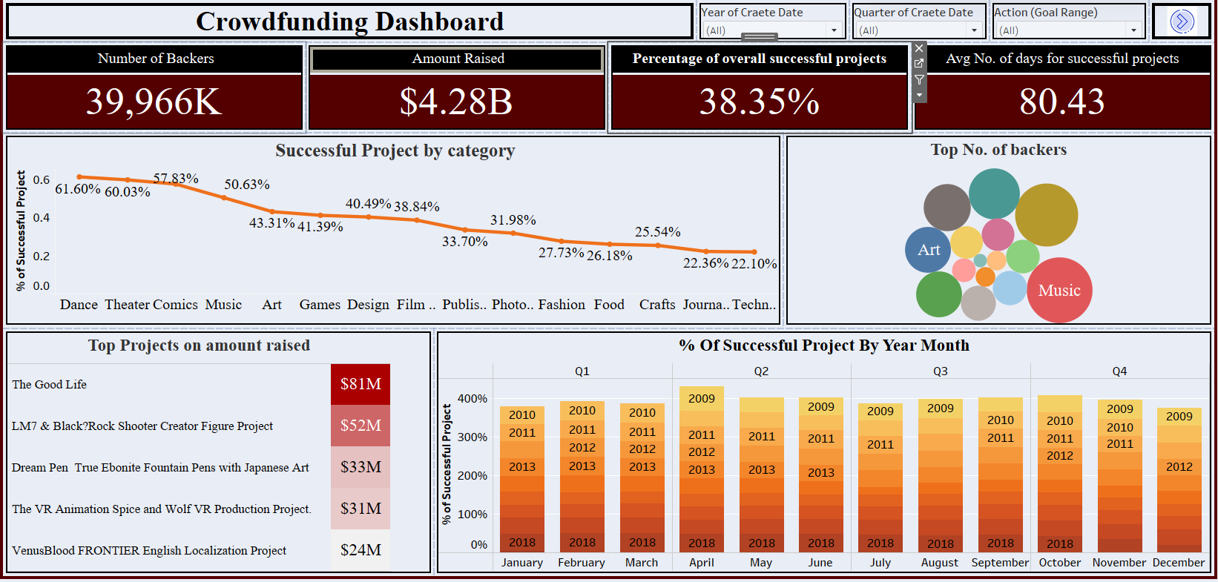
T
A
B
L
E
A
U
There are 39.966K backers in total, indicating a substantial level of interest and participation in crowdfunding projects.
A total of $4.28B has been raised across all projects.
The Good Life with $81M, the highest raised among all projects.

Slide 8
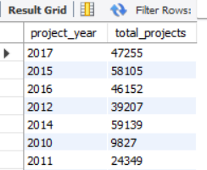
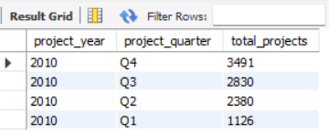
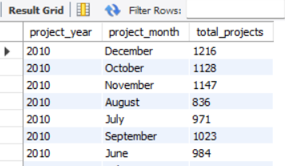
By Year:
The total projects grew over time, starting from 9,827 projects in 2010 to 47,255 in 2017, with notable jumps in 2014 (59,139 projects) and 2015 (58,105 projects).
By Quarter (2010):
In 2010, the number of projects increased steadily throughout the year
By Month (2010):
When broken down by month in 2010, the data reveals a fairly consistent distribution with some variation
S
Q
L
YEAR
QUARTER
MONTH

Slide 9

Conclusion
Growing Credibility and Accessibility
Peak Adoption Years: 2014-2015
Transformation of the Funding Landscape

Slide 10
THANK YOU FOR YOUR ATTENTION.

